Slide 1
+Conciencia Sprint Review 18/10

Slide 2
Table of Contents
01
02
New Backlog
New Designs
03
Next steps

Slide 3
New Backlog
01
We have worked on improving our backlog to allow us to have a better workflow and tasks that are easier to follow.

Slide 4
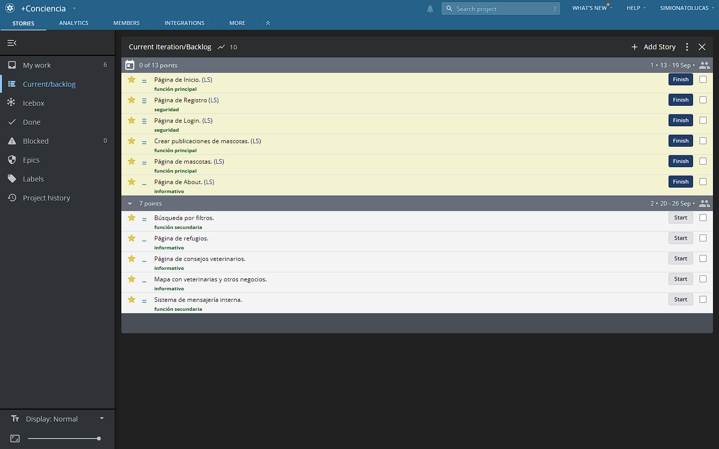
Old Backlog

Slide 5
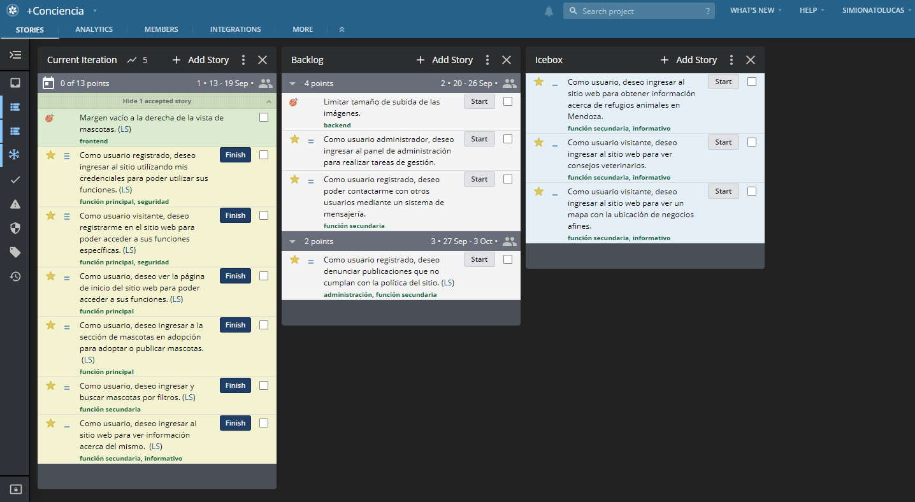
New Backlog

Slide 6
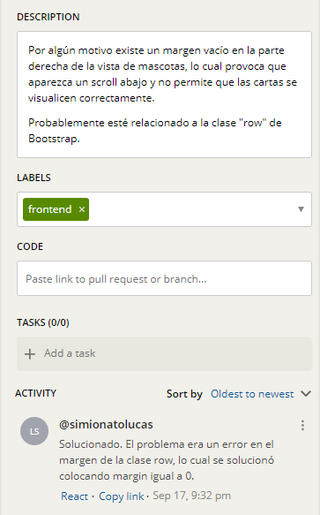
A few things worth noting
We are now using User Stories as task titles.
Improved task descriptions.
Icebox.
Bugs as tasks.
Using comments to communicate progress.

Slide 7

02
New Designs
We are completely changing +Conciencia’s design, again. This time we aim for a modern, minimalistic design.

Slide 8
Let’s check them out

Slide 9


Next steps
03
Continue work on implementing features.
Complete the documentation.

Slide 10
¡Thanks!
Questions?
Presentation by the +Conciencia team
Please keep this slide for attribution

